Slide 1
Nonlinear Control of the inverted pendulum
Professor:Dr Atrianfar

Slide 2

Members:
Melika salehian
Fateme karar
Mahban gholi jafari
Maryam heydari

Slide 3
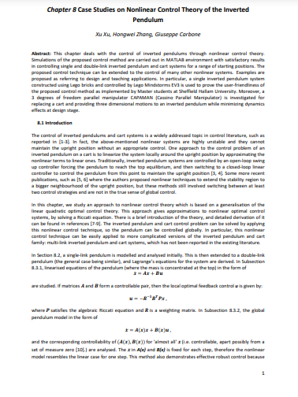
Lecture under observation

Slide 4
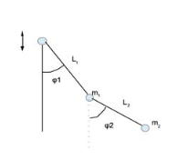
A.1. Introduction
The double inverted pendulum system is an example of a chaotic system. The system is a fast, multivariable, nonlinear and unstable process.

Slide 5
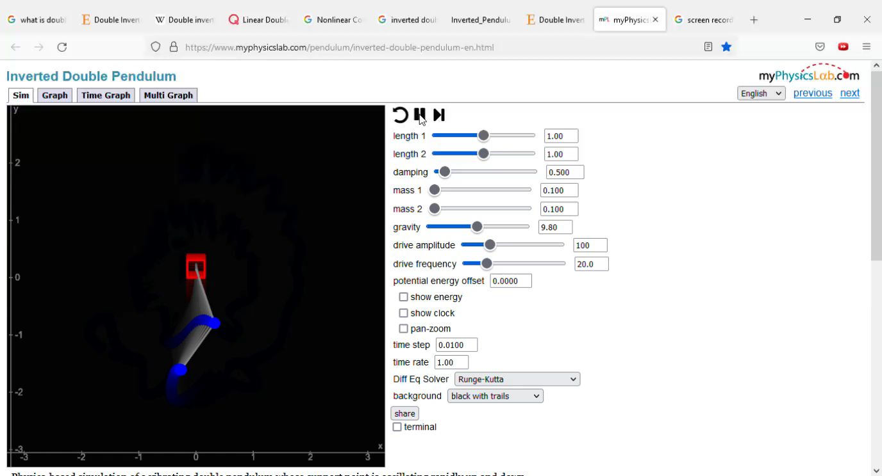

Slide 6
A.1.1. application
01
02
03
the field of defense
aerospace
mechatronic systems

Slide 7


Slide 8

A.2.None Linear equation
A cart inverted pendulum system has been served as a general model for robotic systems. The cart pendulum system is a non-linear, under-actuated system with unstable zero dynamics and must be controlled such that the position is at its unstable equilibrium.
linearized equations of the pendulum (where the mass is concentrated at the top)
$$\dot{x}=Ax+Bu$$

Slide 9
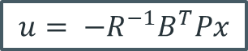
if matrices A and B form a controllable pair, then the local optimal feedback control u
$$u= −R^{−1}B^{T}Px$$
P satisfies the algebraic Riccati equation and R is a weighting matrix.

Slide 10

the Lagrangian approach which calculates the difference between total kinetic energy T and the total potential energy V of the system:
$$L=T−V$$

Slide 11

the Hamiltonian equation which calculates the sum of the two types of energies
$$H=T+V$$

Slide 12
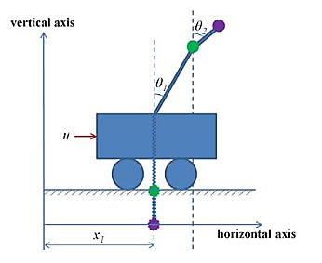
𝜃1 and 𝜃2 represent the angles between the 1st and the 2nd pendulum rods and the vertical axis

Slide 13
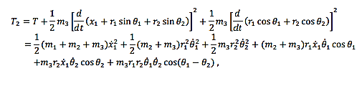
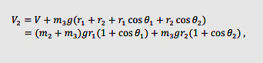
The total kinetic energy of the pendulum-cart system

Slide 14
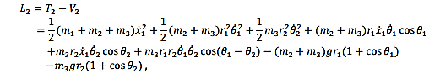
And the result is

Slide 15
A.2.1.components
01
02
03
𝑚3 denotes the mass of the newly added pendulum
04
m1 the masses of cart
07
Buttons (inputs)
05
M2 mass of pendulum
r1 lengths of the original rod
06
g is acceleration due to gravity
R2 length of new rod

Slide 16
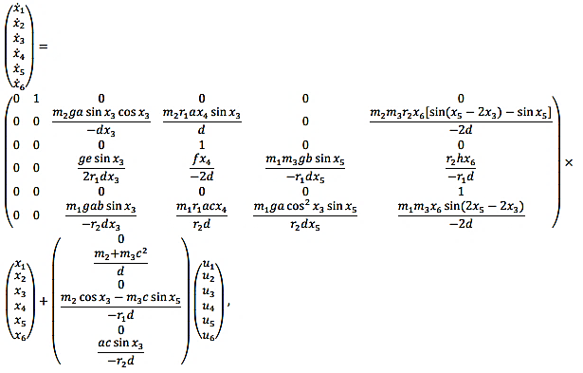

Slide 17
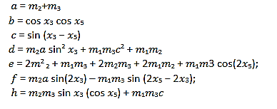
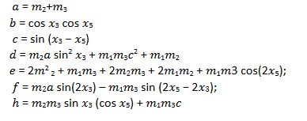

Slide 18
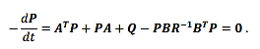
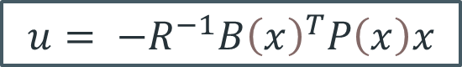
Linearization
A.3.
$$u= {−R}^{−1}{B\left(x\right)}^{T}P\left(x\right)x$$
By implementing the above equation in the state space model we will have

Slide 19
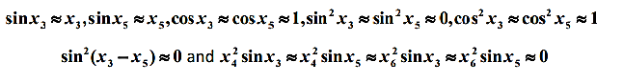
A.3.1 neighbourhood
when the inverted pendulums are kept in a small neighborhood of the vertical upright position. Therefore, x3, x4 x5, and x6 are small. Thus

Slide 20
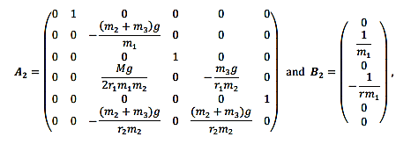
M=2𝑚² ₂ + 𝑚₁𝑚₃ + 2𝑚₂𝑚₃ + 2𝑚₁𝑚₂ + 𝑚₁𝑚3

Slide 21
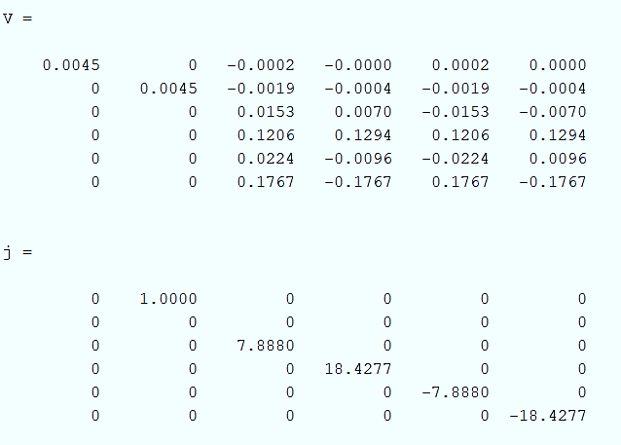
A.4. Jordan block and diagonal form
First we obtained the state space form of the system by the use of ss function in Matlab. With statespace variable the transfer function matrix can be derived

Slide 22
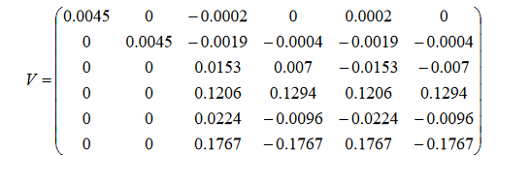
transfer function matrix is

Slide 23
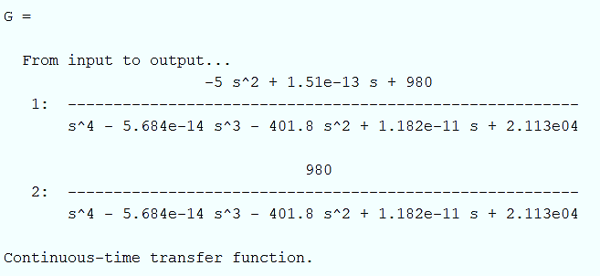
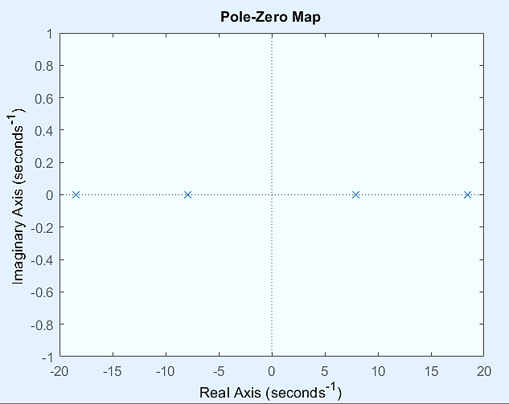
A.5.transform function
Poles = 18.4277, -18.4277, 7.888, -7.888 No zero

Slide 24
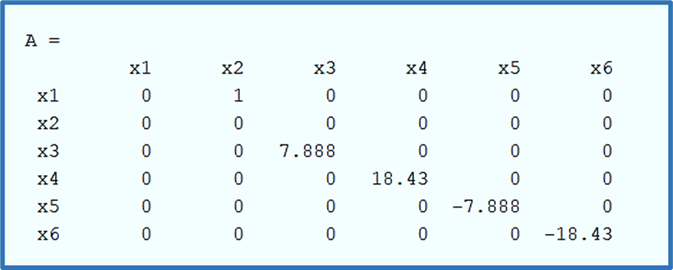
A.6. stability
1-Stability in the sense of Lyapunov : it's to be said if we have 𝑥̇ = 𝐴𝑥
2- Asymptotically stability: If the eigenvalue of A is strictly negative it will be stable in an as asymptotically way

Slide 25
Eigen value : 0, 0, -18.4277, -7.888, 18.4277, 7.888
Asymptotic stability: Eigenvalues should have negative real part Internal stability: the system which is Internal stable should be asymptotic stable and also Lyapunovstable at the same time. Since we have two special values with positive real part, the asymptotic stability condition is notestablished, so it is not internally stable. Since the order of the Jordan block corresponds to zero eigenvalues equal to 2, it is not Lyapunov stableand so not boundary stable

Slide 26
A.7. BIBO stability
Poles = 18.4277, -18.4277, 7.888, -7.888
So the system is not input/output stable (BIBO) because 2 poles of the conversion function are at theright of the imaginary axis

Slide 27
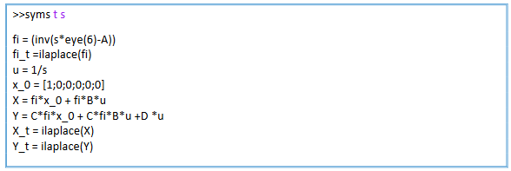
A.8. state transition matrix
Due to the large size of the equations in the resulting matrices, the results are available in the attached MATLAB file

Slide 28
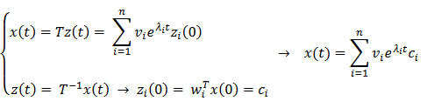


A.9. initial condition
initial conditions in such a way that a certain frequency is not excited from the output
$$Av_{i}= λ_{i}v_{i}$$
$$w_{i}^{T}A= λ_{i}w_{i}^{T}$$
The rows of matrix 𝑤𝑖 𝑇are the left Eigen Vecto
The columns of matrix 𝑣𝑖 are the right Eigen Vecto

Slide 29
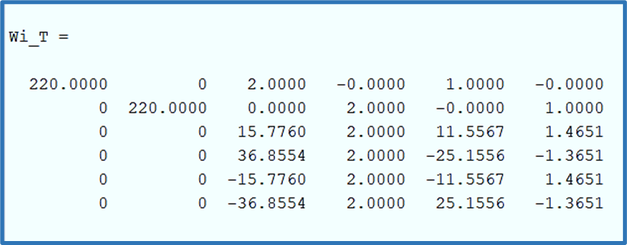
If we do not want to excite the second frequency, given that the third and fifth values of the second row of matrix are zero and not zero in the other lines, we can define the initial conditions as follows

Slide 30
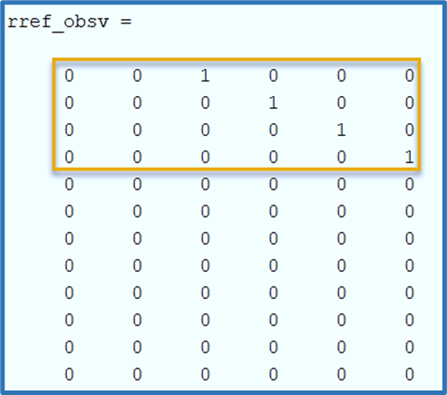
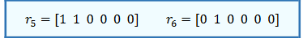
A.10. kalman
The system is controllable but unobservable because the rank of the visibility matrix is 4, so we select 4 independent rows of the matrix observabilit

Slide 31
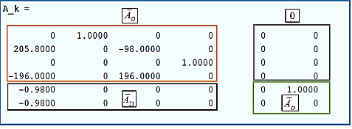
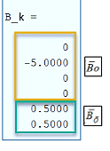
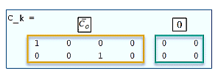

Slide 32
A.11. minimal
to determine the stabilizability and detectablity of the system, it is necessary to determine thecontrollable and visible poles. Invisible poles = 0,0 Visible poles = -18.4277, -7.8880, 7.8880, 18.4277
-All poles are controllable- Due to the fact that the system is controllable, it is also stabilizable, but due to the existence of zero conjugate states which are invisible, the system is detectable

Slide 33
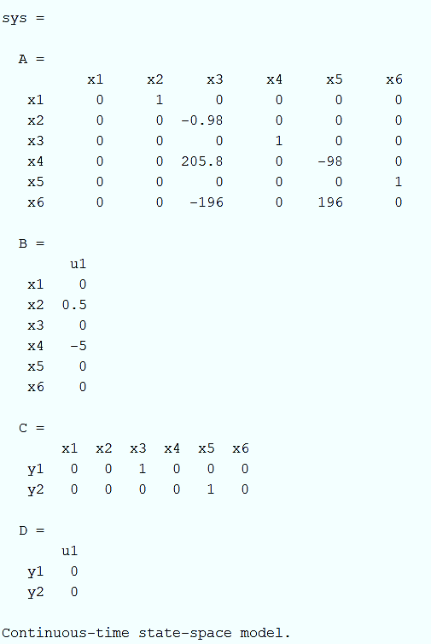
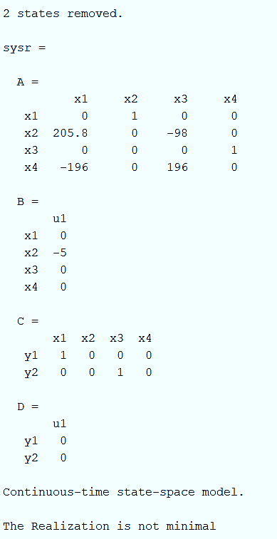

Slide 34
B.1. irreducibility
Initially our system was controllable but not observable so So by dividing the observable part now we have the minimal realization

Slide 36
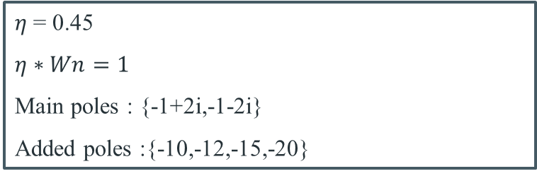
B.2.
In order to make our system a desirable yet function able system we have designed our system with20%overshoot and 4 second rise time with considering this two condition only we can obtain 2 poles as it’s the desirable root for a second order system so in order to keep up with our original system we take the other 4 poles very far to empower our desirable poles and make them dominant.so we have
$η$ = 0.45
$η∗Wn=1$
Main poles : {-1+2i,-1-2i}
Added poles :{-10,-12,-15,-20}

Slide 37
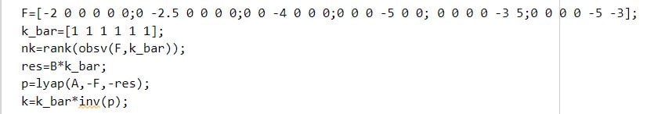
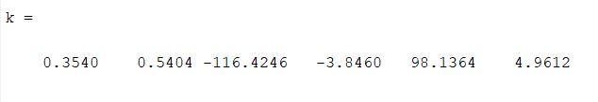

Slide 38
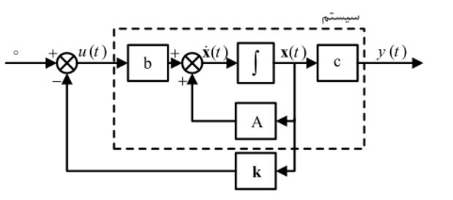
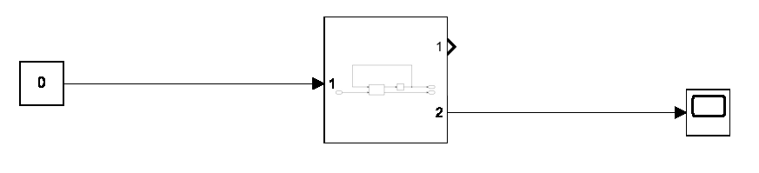
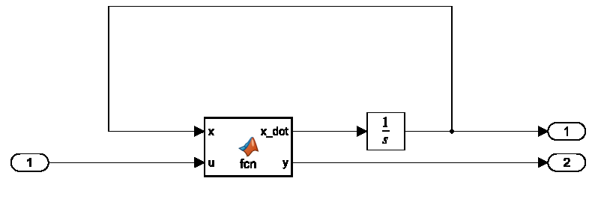
B.3.feedback and simulation
nonlinear

Slide 39
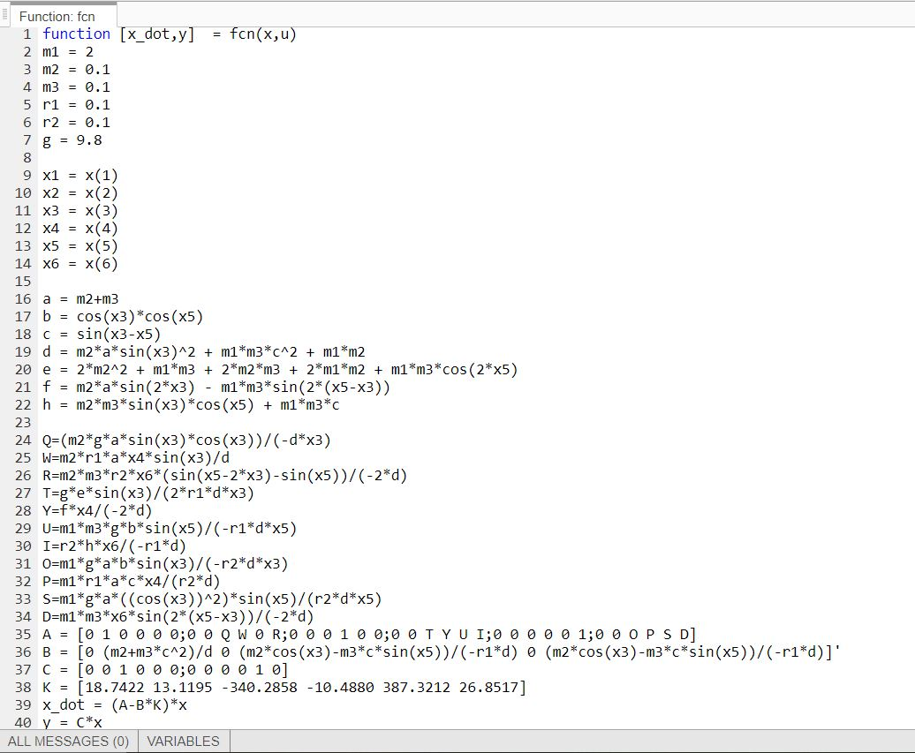

Slide 40
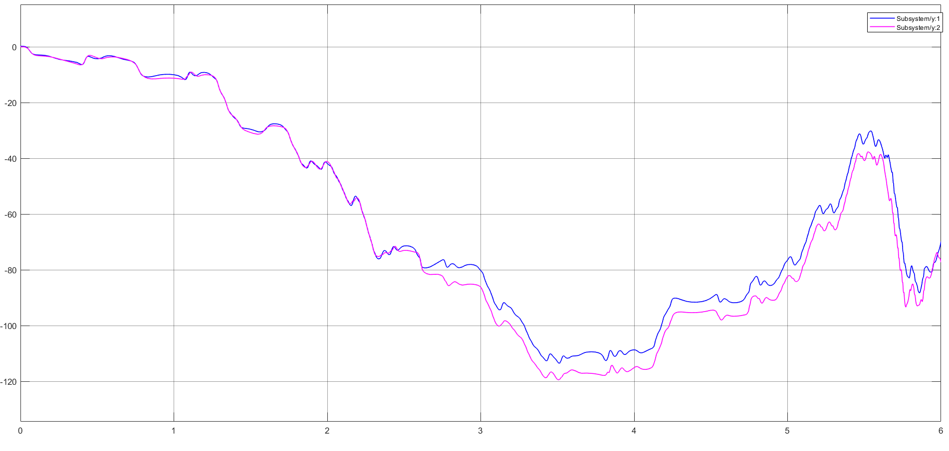
satisfied.

Slide 41
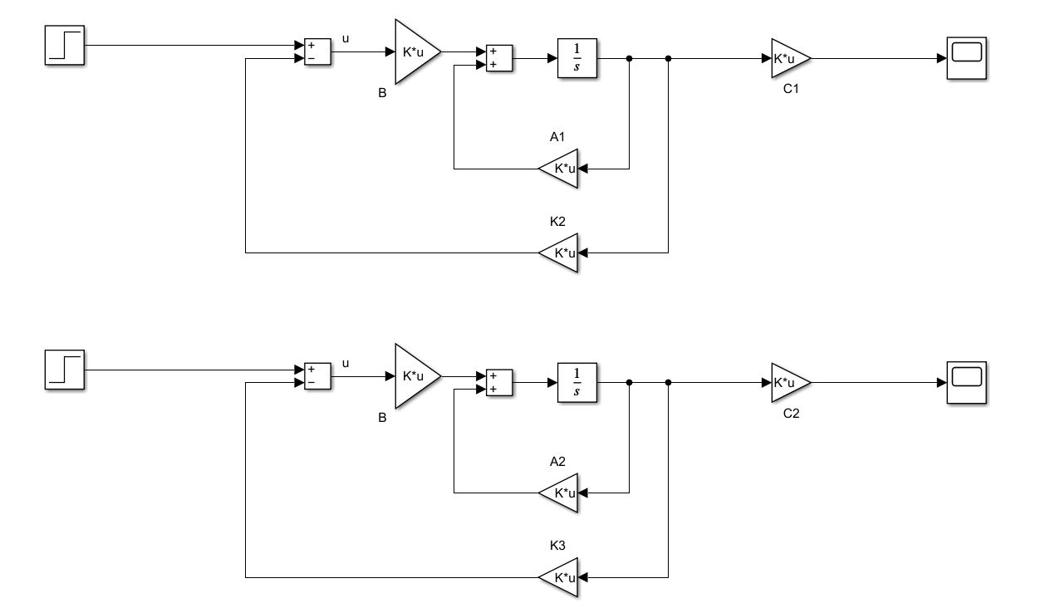
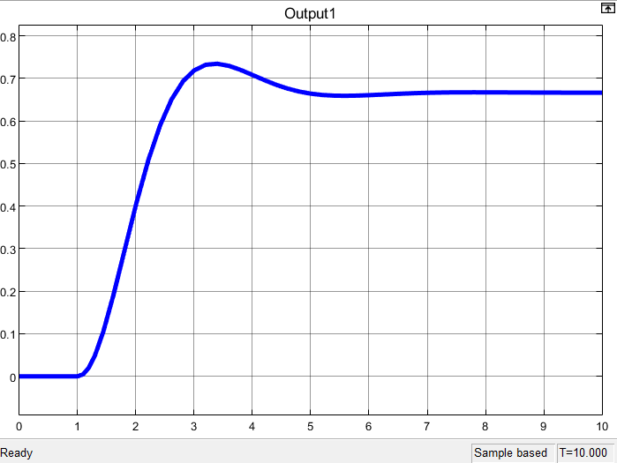
linear
y1پاسخ فیدبک حالت

Slide 42
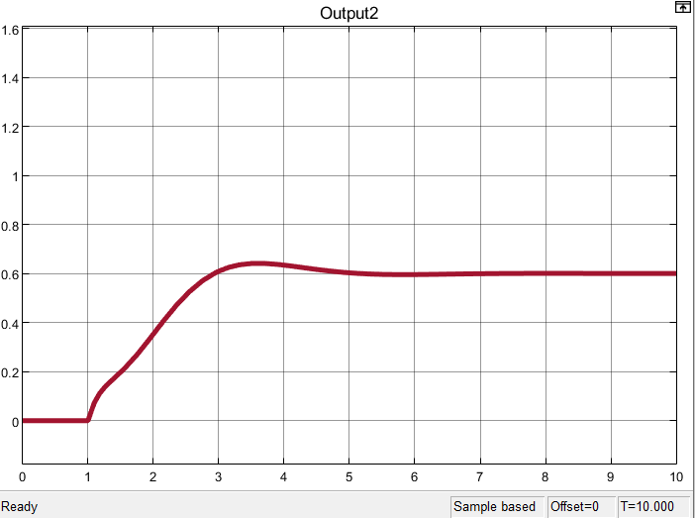
y2پاسخ فیدیک حالت

Slide 43
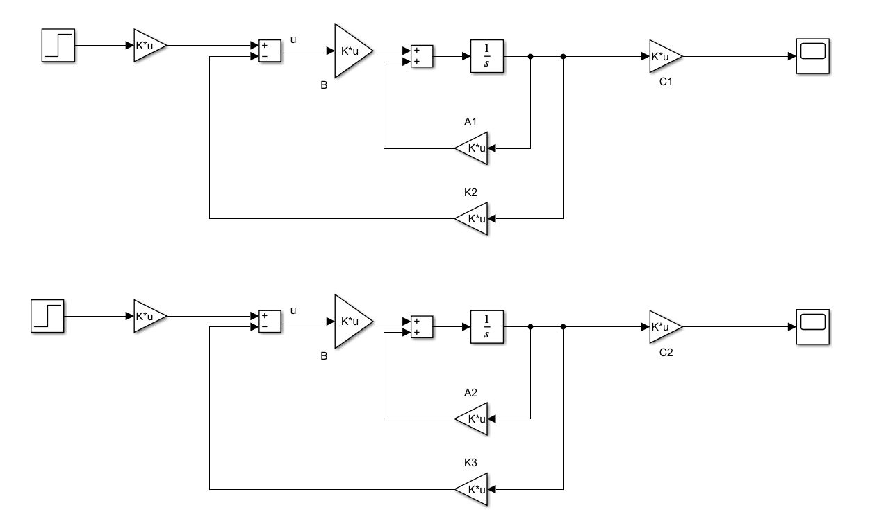
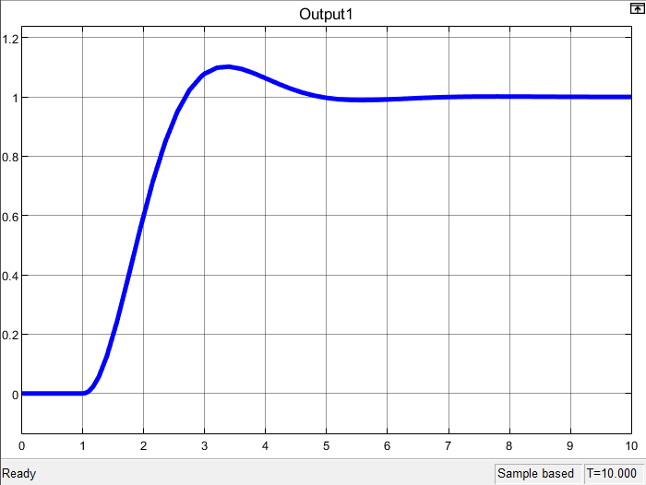
B.5.
y1پیش جبرانساز استاتیک

Slide 44
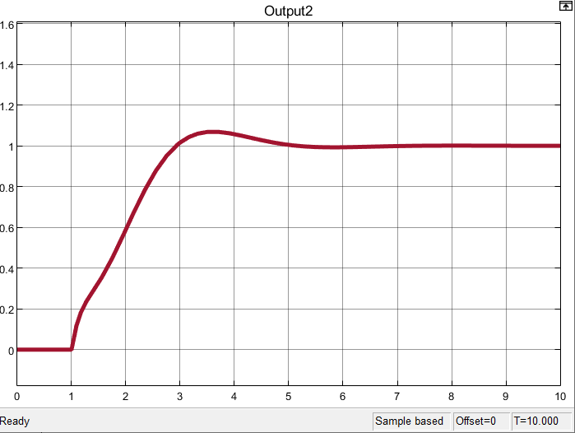
y2پیش جبرانساز استاتیک

Slide 45
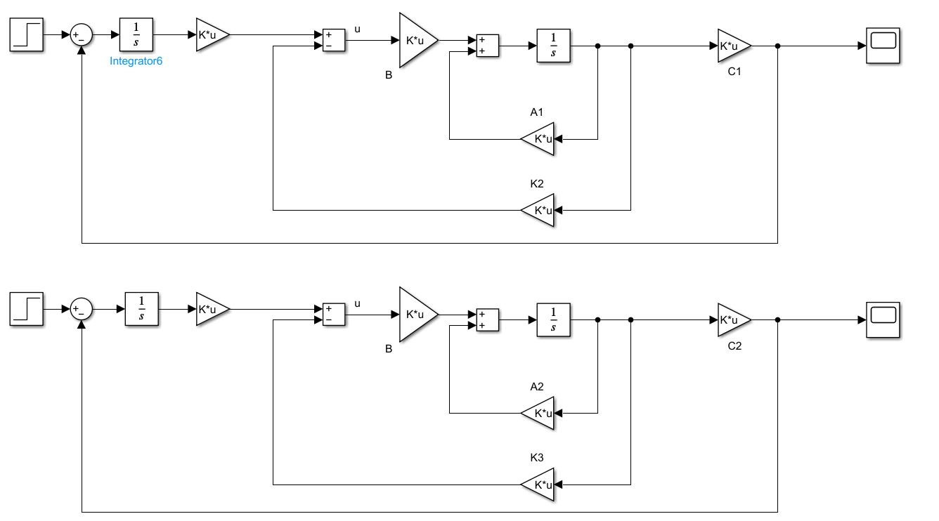
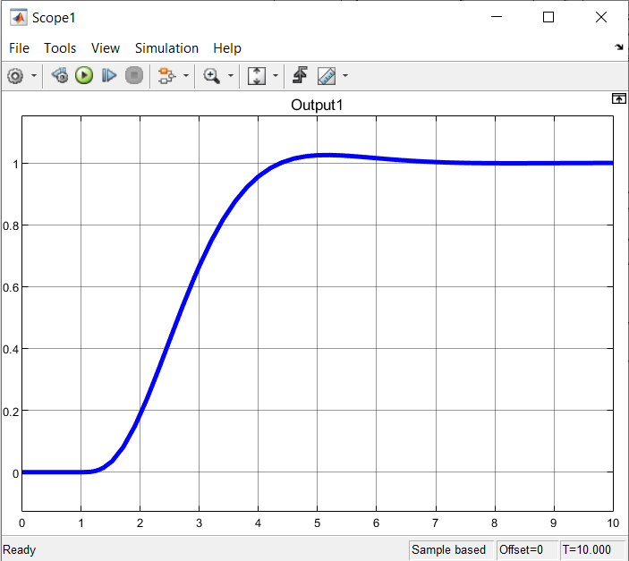
y1دینامیکی

Slide 46
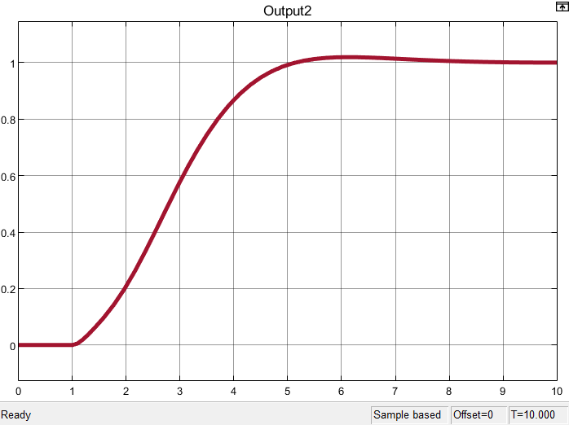
y2دینامیکی

Slide 47
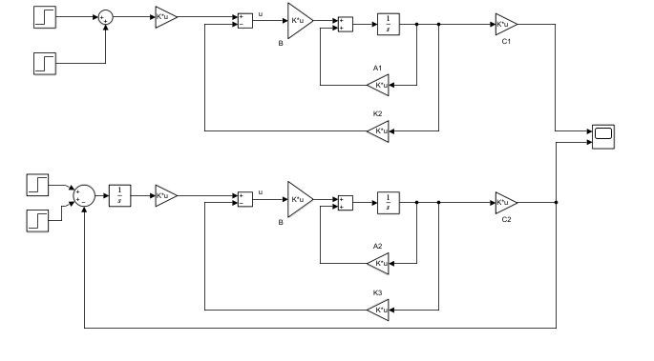
در حضور اغتشاشy1مقایسه استاتیکی و دینامیکی

Slide 48
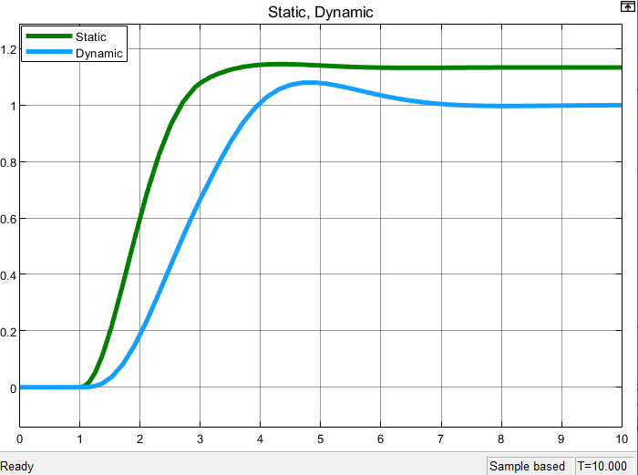
در حضور اغتشاشy1مقایسه استاتیکی و دینامیکی

Slide 49
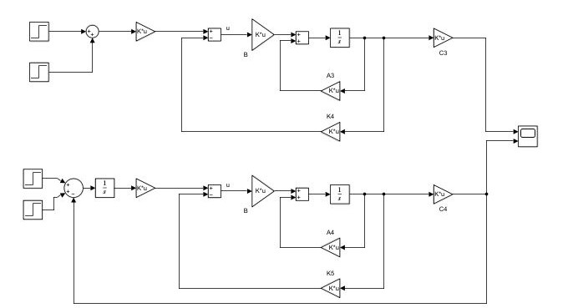
.
در حضور اغتشاشy2مقایسه استاتیکی و دینامیکی

Slide 50

در حضور اغتشاشy2مقایسه استاتیکی و دینامیکی

Slide 51


C.1. Full order State Observer
result

Slide 52


C.1.1 reduced order State Observer

Slide 53

دینامیکی کامل

Slide 54


دینامیکی مرتبه کامل
y2
y1دینامیکی مرتبه کامل

Slide 55

دینامیکی رویتگر مرتبه کاهش یافته

Slide 56

سیمولینک استاتیکی مرتبه کامل

Slide 57


y2استاتیکی رویتگر کامل
y1استاتیکی رویتگر مرتبه کامل

Slide 58

سیمولینک استاتیکی مرتبه کاهش یافته

Slide 59


y1استاتیکی مرتبه کاهش یافته
y2استاتیکی مرتبه کاهش یافته

Slide 60


y1دینامیکی مرتبه کاهش یافته
y2دینامیکی مرتبه کاهش یافته

Slide 61
Sources:
https://www.myphysicslab.com/pendulum/inverted-double-pendulum-en.html
file:///C:/Users/admin/AppData/Local/Temp/351_27435_EE412_2019_1__2_1_0%206%20EE412%20Lec6%20Full%20order%20state%20observer_design.pdf
https://www.sciencedirect.com/topics/engineering/double-inverted-pendulum
https://www.math.arizona.edu/~gabitov/teaching/201/math_485/Final_Reports/Inverted_Pendulum_Final_Report.pdf
https://www.quora.com/How-is-this-equation-for-an-inverted-pendulum-derived
https://www.quanser.com/products/linear-double-inverted-pendulum/
-----------Xuetal.Chapterrev4.pdf

Slide 62
THANK YOU Any Questions?

